Slide 1
ADVANCED BUSINESS INTELLIGENCE
AT CARDINAL HEALTH
MIS-636B
Professor Joseph Morabito
TEAM-2
Isha Goyal
Rucha Patil
Rahul Saini
Bhumika Patoliya
Kunal Batra Krishna Lala

Slide 2
Agenda
Executive Summary
Gaps in the Current Scenario
Data Warehousing and Business Intelligence
Common Environment and Key Component for BI
Cardinal Health’s Medical Products & Services Business
The SAP R/3 and Data Warehouse Initiatives
Advanced BI Projects at Cardinal Health
The Nature of Advanced BI Teams
The Attributes of Cardinal Health’s BI Teaming Process
The Nature of the Organizational Infrastructure Enabling Cardinal Health’s Advanced BI Capability
Recommendations
Conclusion
Isha Goyal

Slide 3
Executive Summary
Cardinal Health’s Medical Products and Services implemented SAP R/3
Built a data warehouse for business reporting
This has evolved into an advanced business intelligence(BI) capability
Key Components of advanced BI environment are:
Cardinal Health’s data infrastructure
Information culture
Isha Goyal

Slide 4
Gaps in the Current Scenario
Installed IT Applications are underutilized
Narrow feature breaths are employed
Infrequent extensions of available features
Solution: Data Warehousing
Isha Goyal

Slide 5
Data Warehousing and Business Intelligence
Data Warehousing
Technologies associated with creating repositories of cleansed, formatted and well integrated data that enable business professionals to analyze and access that data for routine and ad hoc reports
Business intelligence
Collection of data, analyzing it to detect patterns and meanings within the data, extracting information from these analyses , and turning this information into actionable knowledge
Isha Goyal

Slide 6
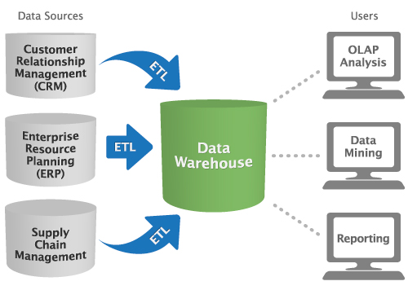
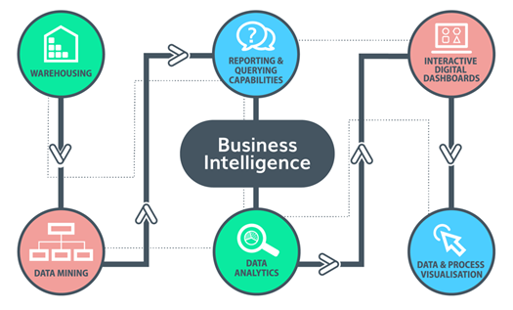
Data Warehousing and Business Intelligence
Isha Goyal

Slide 7
Common Environments for BI
A shared service:
Central BI capability with a single data warehouse and analytical tools
Professional BI staff skilled in accessing data and using the tools
Targeted data marts:
Focused data warehouses to meet the BI needs of specialized user groups
Post training, user groups meet BI needs themselves
Menu-Driven reporting systems:
Known as “Executive information system” when targeted at firm’s executives
Business professionals can access a data warehouse to
Produce standard reports
Initiate simple queries
Isha Goyal

Slide 8
Key components for advanced BI
Data Infrastructure
Includes data warehouse, an enterprise-wide data model, data access and analysis tools, and a support infrastructure
Provides universal access to common set of data to professionals
Information Culture
Business professionals justify data-driven approach to making plans and taking decision
Isha Goyal

Slide 9
Cardinal Health’s Medical Products & Services Business
Cardinal Health study includes the largest U.S manufacturer and distributor of medical,surgical, & laboratory products and services used by healthcare providers.
Example-Surgical instruments,Drapes,Gowns,Gloves.
** Supplies from over 2,600 manufactures to nearly 80,000 sites of care
Cardinal Health had a rich and successful heritage
Rucha Patil

Slide 10
Cardinal Health’s Medical Products & Services Business
The Healthcare Industry
The heritage has three direct influences on the organizational environment:-
Its culture is highly receptive to IT-enabled business innovation.
Executives & Senior Employees have long tenures.
Due to the long employee tenures, personal networks are dense and rich.
Rucha Patil

Slide 11
The SAP R/3 and Data Warehouse Initiatives
SAP / Data Warehouse Implementation Objectives
In 1995 (just prior to the Baxter spin-off), Baxter senior management decided to implement SAP R/3® to accomplish three objectives:
To Resolve the Y2K Issue (The Year 2000 Bug).
To Replace the outdated legacy systems.
( Multiple databases with similar but unsynchronized data, inferior user interfaces, unconnected
systems )
Decommission some 20 end user computing systems.
( which were effective within single business units but created huge information challenges
across units )
Rucha Patil

Slide 12
The SAP R/3 and Data Warehouse Initiatives
SAP / Data Warehouse Project Goals
Planning for the SAP implementation and its associated business process reengineering efforts occurred during 1995 and 1996. The $64 million SAP implementation took place in 1997 and 1998.
The goals of this initiative, which provided the foundation for Cardinal Health’s current advanced BI capabilities are:
Create a single source for all data.
Achieve high responsiveness with business transactions.
Improve quality and correctness of data.
Switch reporting mindset from push to pull.
Reduce business reliance on IT.
Lower IT operation costs.
Rucha Patil

Slide 13
The SAP R/3 and Data Warehouse Initiatives
Using the Data Warehouse as a “Reporting System”
The Management decided to use Data Warehouse instead of using the SAP Reporting Tool based on the following factors:
The many stories in the business press about ERP failures gave management a strong incentive to simplify the SAP implementation as much as possible.
Management was concerned that SAP could not handle the expected high transaction processing volumes. Separating transaction processing and business reporting would improve transaction processing responsiveness and would also protect the operational systems.
Finance management was not satisfied with the report generation tool in SAP.
Rahul Saini

Slide 14
The SAP R/3 and Data Warehouse Initiatives
Data Warehouse Design
Component | Description
Database | Oracle
Interface | Homegrown
Client Tool Set | SAP single table inquiry tool. Business Objects tool Set. Download capability into Microsoft Access, SAS and Excel.
Client Interface | Hierarchically structured (for sales force). Web based front-ends (for customers and suppliers). Business Objects tool set (for most employees).
Data universes | Sales History, Invoice, Inventory, Purchase Order, Rebate, pricing, Accounts Receivable, Accounts Payable, Financial, Fixed Assets, Human Resources.
Rahul Saini

Slide 15
The SAP R/3 and Data Warehouse Initiatives
Reengineering the Reporting System
As part of the overall business process reengineering effort that accompanied the SAP implementation, Cardinal Health formed teams of business analysts users and IT staff to create a uniform, simplified reporting structure across the firm. Basically the IT members of these teams works on the users feedback and make custom templates for them.
Results achieved:
A set of stable, repeatedly used Business Objects templates. This enabled users to get static reports.
An ad-hoc reporting capability. whereby a user could modify an existing Business Objects template or build a new one to access data in the warehouse.
Rahul Saini

Slide 16
The SAP R/3 and Data Warehouse Initiatives
Other Implementations for the Successful Deployment
The other factors that the Management decided to successfully implementing the Data Warehouse and the Reporting Systems are:
Data Warehouse Marketing and Training.
(Proper training sessions for the end user so that operational effectiveness can be maintained)
Creating Finance Super Users.
Turning Ownership of Data and Report Templates Over to the Business Units.
Turning Off the End User Computing Systems.
Evolving the Data Warehouse. (helps in Improving and Extending Data Warehouse)
Rahul Saini

Slide 17
Advanced BI Projects at Cardinal Health
Cardinal Health usually created BI teams on-the-fly
They followed a 3 step BI process
Check whether the DW might be useful to solve the problem
Identify the experts and skills needed for the job
Put together a team from appropriate functional areas
This was key to advanced BI capabilities and accomplish advanced BI tasks.
5 success stories in following slides
Bhumika

Slide 18
Advanced BI Projects at Cardinal Health
Success Story
Creating a List of Inventory Items to Drive Sales
Problem: Growing problem of excess inventory
Cause: Stocking of multiple substitutes
Solution: Reduce number of items using DW such that most requirements are met while availability can be guaranteed
End Result: Only products that represented best value for the money were kept in the list
Bhumika

Slide 19
Advanced BI Projects at Cardinal Health
Success Story
Creating a List of Inventory Items to Drive Sales
Problem: Frequent out-of-stock at a delivery plant
Solution: Automatically re-routing inventory from elsewhere
End Result:
Reduced manual work
Better sales
Fewer returns
Reduced inventory
Bhumika

Slide 20
Advanced BI Projects at Cardinal Health
Success Story
Giving Customers Access to Data through Entelligence
Problem: No easy way for customers to get their data
Solution: Create a web-based access for customers to see their data & reports called Entelligence Purchase Management System
End Result:
Cost savings
Generated subscription fees
Customer retention
Bhumika

Slide 21
Advanced BI Projects at Cardinal Health
Success Story
Standardizing Human Resource Data and Reports
Problem: Each HR division needed a separate report template
Solution:
Use DW and use Business Objects to “pull” data
Creation of master templates
Train the team to modify templates
End Result:
Fewer templates to maintain
Uniformity in reporting
Bhumika

Slide 22
Advanced BI Projects at Cardinal Health
Success Story
Reporting on Supplier Diversity for the Federal Government
Problem: Need to create supplier diversity reports for Federal Government
Solution:
Draw balance sheet and accounts payable data from DW
Make a team of financial analysts from corporate finance
Finalize the template for these reports, which included over 180 queries
Bhumika

Slide 23
The Nature of Advanced BI Teams
These five teams were clearly quite different from one another. However, they did possess six common capabilities:
Comprehension of the business situation(problem or opportunity) to be addressed,
Understanding of the business practices associated with the situation,
Ability to locate and retrieve needed data(via the data warehouse or social networks) in order to re-solve the situation,
Proficiency with Business Objects, to access data in the data warehouse,
Expertise in data integration, to pull together and work with data from a variety of sources (data warehouse, SAP R/3, other information systems, etc.)
Adeptness in data analysis(using Excel, MS-Access, or SAS).
Kunal Batra

Slide 24
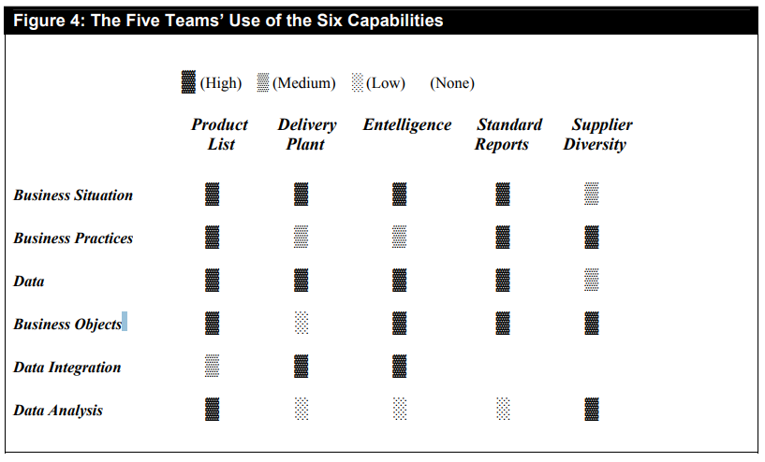
The Nature of Advanced BI Teams
Kunal Batra

Slide 25
The Attributes of Cardinal Health’s BI Teaming Process
Project Leader’s Ability to identify individuals across the enterprise who had the knowledge to solve the problem at hand
Team members’ ability to identify, access, and acquire the needed knowledge, no matter where it existed in the enterprise.
Team’s ability to diffuse its learnings to others.
Kunal Batra

Slide 26
The Nature of the Organizational Infrastructure Enabling Cardinal Health’s Advanced BI Capability
An “organizational infrastructure” is conceptually similar to a “technical infrastructure.”
An organizational infrastructure develops as a function of the policies and practices that frame organizational life, both formal and informal.
Formal: Evaluation systems, control systems, resource allocation procedures, HR practices, etc.
Informal: Leadership styles, supervisory feedback, co-worker interactions, etc.
Two aspects of Cardinal Health’s organizational infrastructure core that are relevant to employees’ ability to leverage the data warehouse:
The Data Infrastructure
The Information Culture.
Kunal Batra

Slide 27
The Nature of the Organizational Infrastructure Enabling Cardinal Health’s Advanced BI Capability
The BI Aspects of the Data Infrastructure:
An enterprise-wide data model
An enterprise-wide, limited set of data access tools
A robust support environment
The BI Aspects of Cardinal Health’s Information Culture:
A data-driven decision style
Business-led IT decision making
Dense and robust social networks
“Pull” reporting structures
Kunal Batra

Slide 28
Recommendations
Data Warehouses are the foundation of advanced BI ability
Data can be manipulated, extracted, summarized and combined to find problems and obtain solutions
Company adoption of Enterprise-Wide advanced BI capability
A company’s core infrastructure and information culture becomes the backbone of advanced BI capabilities
Krishna

Slide 29
Recommendations
Data Warehouses are the foundation of advanced BI ability
Data can be manipulated, extracted, summarized and combined to find problems and obtain solutions
Company adoption of Enterprise-Wide advanced BI capability
A company’s core infrastructure and information culture becomes the backbone of advanced BI capabilities
Employees are able to capture, access and identify problems
Krishna

Slide 30
Recommendation #1
Establish an organization climate where business professionals are expected to be in command of their own information destiny
Employees have control of their own data
Two important qualities to establish an organizational climate
Employees must understand business value of fact-based data when making decisions
Employees at all corporate tiers should be technology efficient
Actions to move in this direction
Decentralize IT
Build an efficient metric portfolio for general access to drive business decisions
Reduce frequency of standard reports
Krishna

Slide 31
Recommendation #2
Encourage Rich Social Networking across the Enterprise
Adopt Employee Network culture to allow employees to co-mingle, and make knowledgeable decisions.
Actions companies can take to foster employee social networking
Long-term impacts of planned workforce reduction
Value tenure during workforce reductions
Establish cross-unit paths for employees to form interdepartmental work groups
Make use of cross-functional groups to full capacity
Use virtual teams instead of co-located teams
Commingle workspaces
Implement knowledge management capabilities
Implement enhanced communication and collaboration capabilities
Hold meetings to bring together diverse employee communities
Krishna

Slide 32
Recommendation #3
Establish a distributed support infrastructure that emphasizes local “first-responders”
Aggressive use of data warehouse
Cardinal Health employees rely on super users and unit support staff to answer questions and provide expertise; known as first-responders
Actions to develop support infrastructure
Establish business roles that focus on extensive data use throughout the enterprise
Provide universal data warehouse training
Provide a highly visible escalation process
Include an individual’s responsiveness to requests in performance evaluation
Krishna

Slide 33
Conclusion
Companies today want to see demonstrable results through data.
Companies invest in data warehousing to improve their competitive advantage
“Queryable source of data in the enterprise” - data delivered by information technology to the company
Advanced BI capabilities become the backbone of the organization’s competitive advantage
Cardinal Health uses its advanced BI structure and Data Warehouse Infrastructure to make business decisions, and has become an integral asset to its competitive capacity
Integrity and accessibility of data have allowed employees to readily obtain information, build metrics and business Intelligence to drive fact-based business decisions.
Krishna

Slide 34
Thank you!

